Slide 1
Variational Autoencoders GUI
Christos Kormaris

Slide 2
How to Run the GUI
First, browse to the directory "vaes_gui" of the thesis project and install the Python dependency libraries, by typing:
pip install -r dependencies.txt
Open a console (terminal) in Unix/Linux or a command prompt in Windows with Python 3 installed and run:
python gui.py

Slide 3
How to Run the GUI (part 2)
To create an executable file for the GUI (".exe"), which you can run anytime from a Windows environment, type:
pip install pyinstaller
pyinstaller gui.spec
Then, download all the datasets from the URLs in the file "datasets_urls.txt" and move them to the newly created "dist" folder. Inside, there should be a folder with the name "vaes_gui", which contains the executable file "vaes_gui.exe".

Slide 4
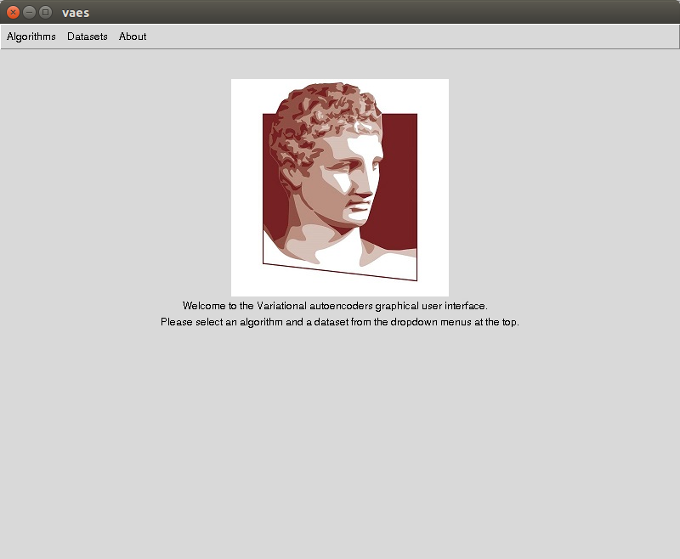
GUI Welcome page.

Slide 5
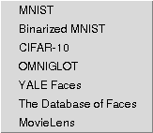
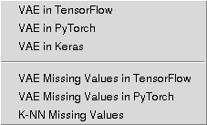
GUI Algorithms and Datasets dropdown menus.
GUI Algorithms dropdown menu.
GUI Datasets dropdown menu.

Slide 6
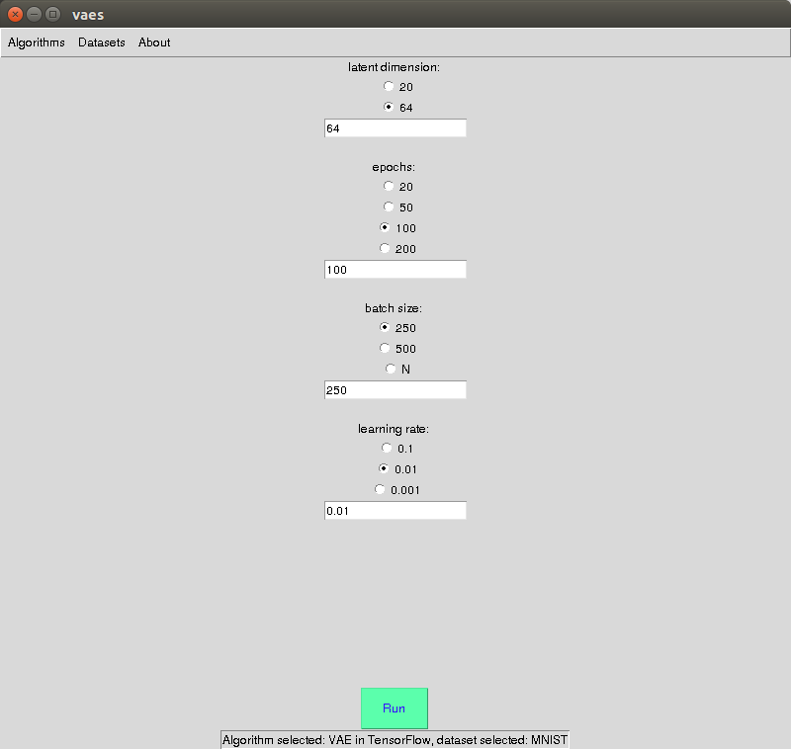
GUI VAE in TensorFlow, MNIST dataset.

Slide 7
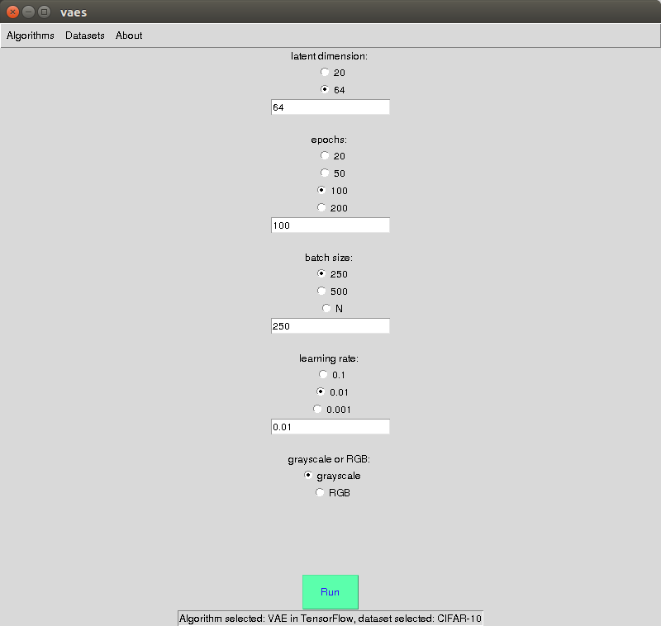
GUI VAE in TensorFlow, CIFAR-10 dataset.

Slide 8
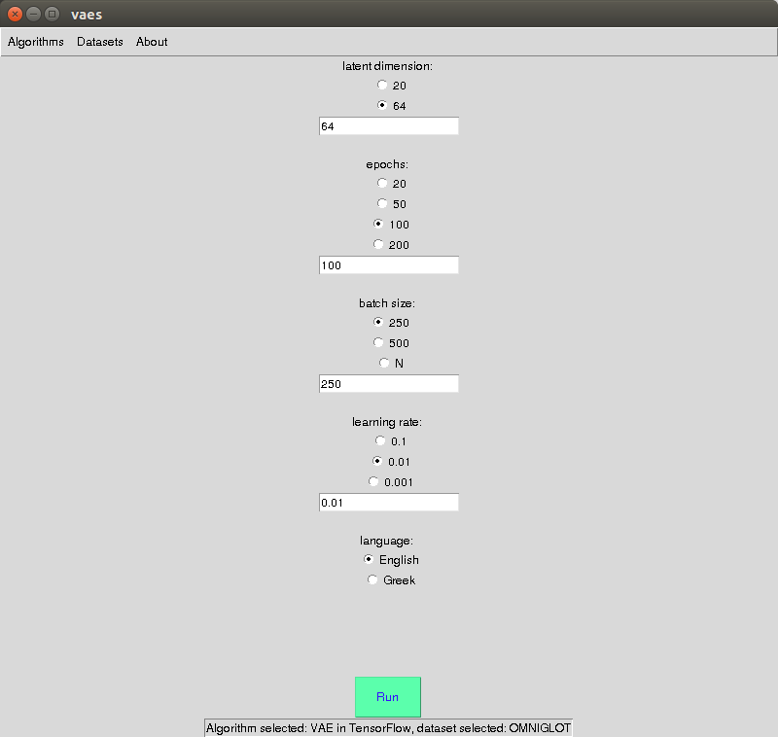
GUI VAE in TensorFlow, OMNIGLOT dataset.

Slide 9
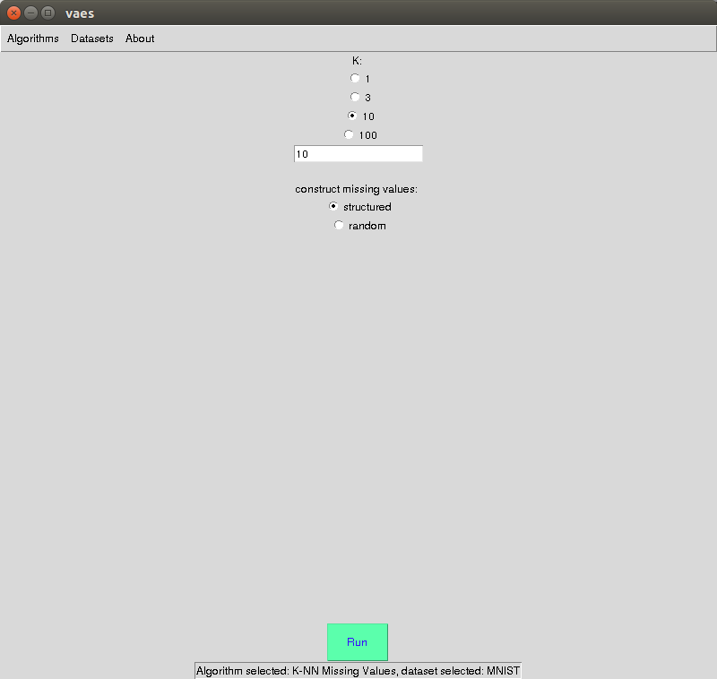
GUI K-NN Recommendation System, MNIST dataset.

Slide 10
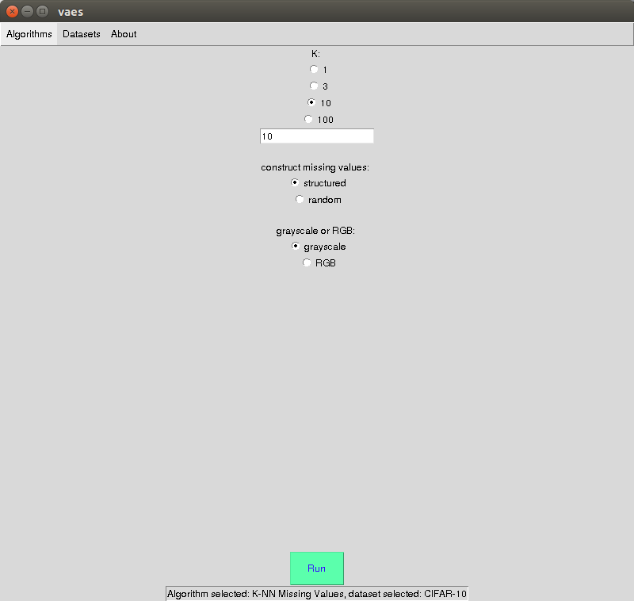
GUI K-NN Recommendation System, CIFAR-10 dataset.

Slide 11
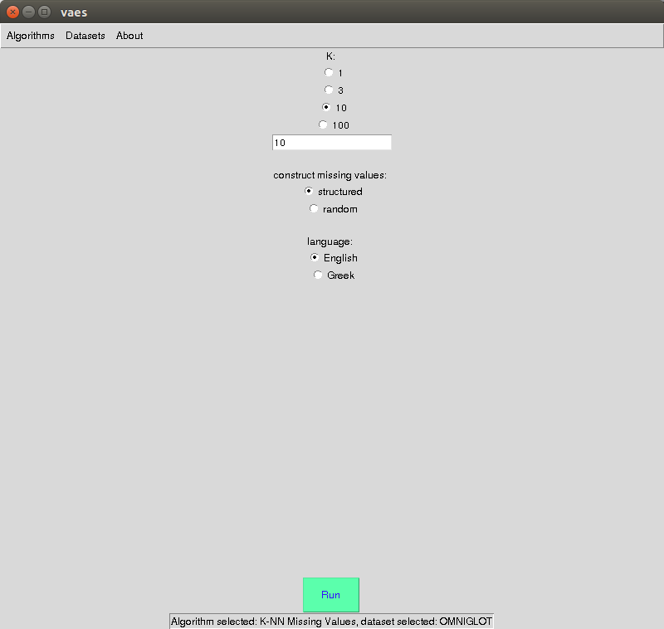
GUI K-NN Recommendation System, OMNIGLOT dataset.

Slide 12
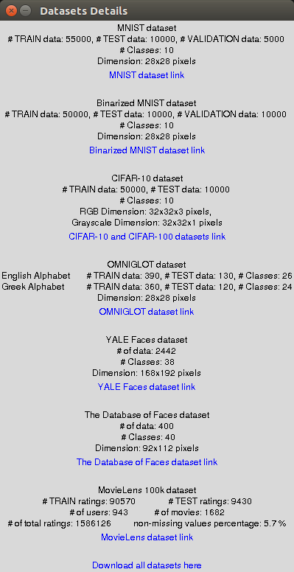
GUI datasets details.

Slide 13
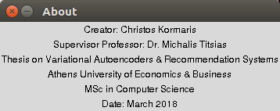
GUI About.

